Slide 1


King county data set
DS EDA PROJECT | Analysis for Client Nicole Johnson

Slide 2

Client
Nicole Johnson
Buyer
Preferences:
Lively, central neighborhood, middle price range, right timing (within a year)

Slide 3

THE ORIGINAL DATASET
The dataset contains records of house sales in King County, including detailed property features and sales information of 21,597 sales
Key Features: Each record includes variables such as house ID, sale date, selling price, number of bedrooms and bathrooms, …
Geographical Data: The dataset includes geographical coordinates (latitude and longitude) and ZIP codes, allowing for location-based analysis of property values.
Temporal Aspect: Sales dates are included, enabling analysis of trends over time within the dataset.
Extended Features: Additional features like square footage of above and basement areas, as well as living and lot area for neighboring properties (15 nearest), provide comprehensive insights into property characteristics and their surrounding context.

Slide 4
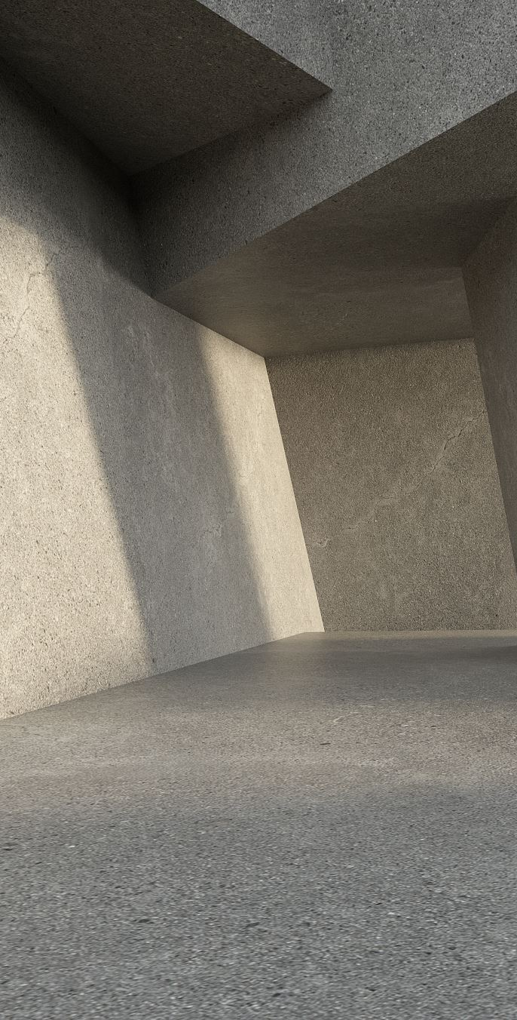
DATA CLEANING
MISSING VALUES on renovation, basement, waterfront, view was treated as if the correspinding properties did not have these features
DUPLICATES have been removed
DATA TYPES Have been corrected (e.g. price date was an object)
OUTLIERS have been removed

Slide 5
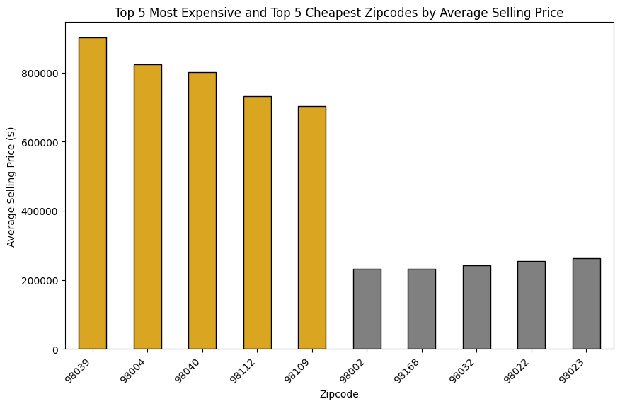
Key Insight #1 Location determines property values

Slide 6
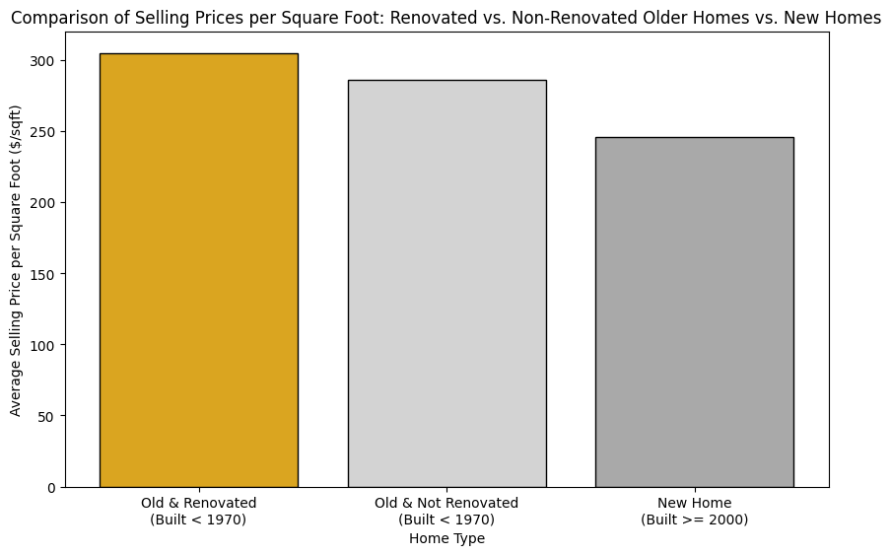
KEY insight #2 old is more expensive than new

Slide 7
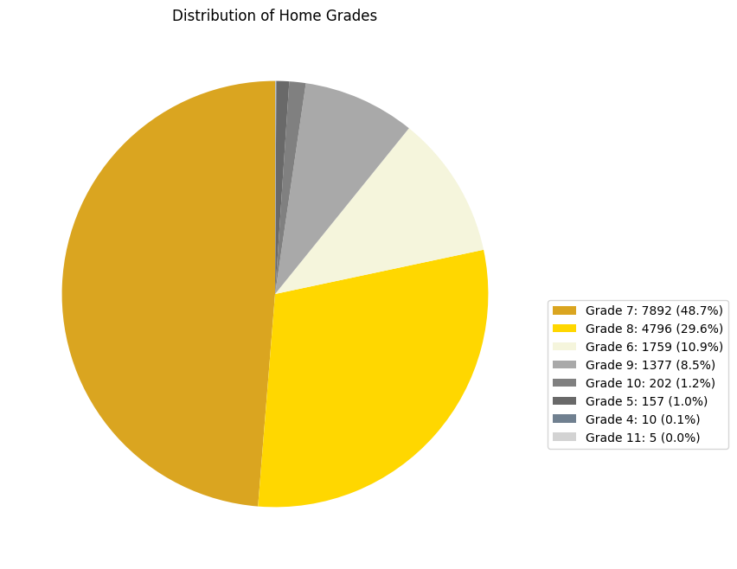
Key insight #3 Above-average grades

Slide 8
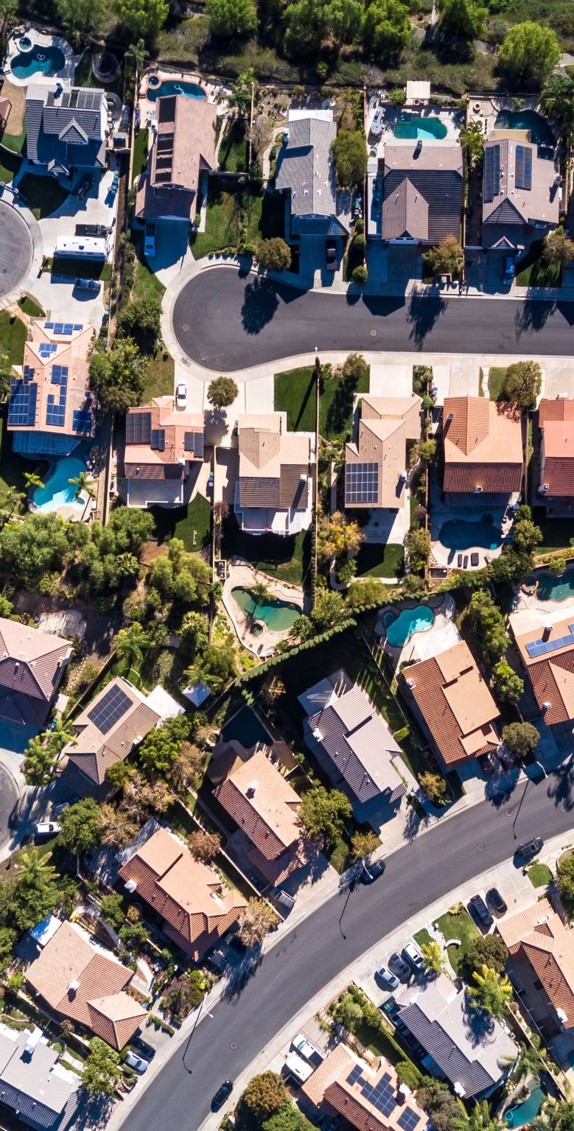
Central & Lively Neighboorhood Assumptions
High Population Density: Higher population density often correlates with central and lively areas
→ average living space of nearby homes / average lot size of nearby homes
Urban ZIP Codes: Central locations are likely to be in more urbanized areas.
→identification of the top 20 ZIP codes with the most listings in the dataset as potential urban areas.

Slide 9

MIDDLE PRICE RANGE Assumption
The middle price range for the houses in the dataset is between $300,000 and $556,825. This range represents the middle 50% of house prices

Slide 10
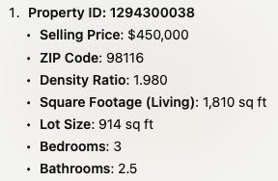
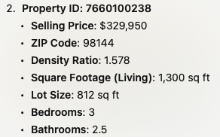
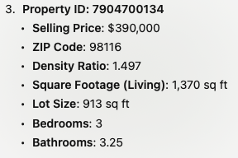
TOP 3 Properties that meet the criteria

